Slide 1
GCSE Biology Microbes and Disease

Slide 2
What are pathogens?
A pathogen is a microorganism that causes a disease.
All types of pathogen have a simple life cycle. They infect a host, reproduce themselves or replicate if it is a virus, spread from their host and infect other organisms.
There are four main types of pathogens:
1. Viruses
2. Bacteria
3. Fungi
4. Protists

Slide 3
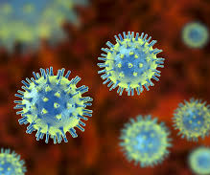
What are viral diseases?
Viruses are not alive because they do not complete all of the seven life processes
They are made of a relatively short length of genetic material DNA which is surrounded by a protein coat.
They can often survive outside a host for long periods of time.

Slide 4
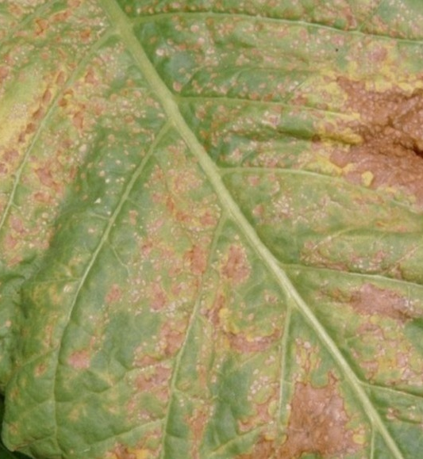
Tobacco Mosaic Virus
It is transmitted by contact between plants, either naturally or through the hands of farmers
It infects the chloroplasts of plant leaves and changes their colour from green to yellow or white in a mosaic pattern. It can also make leaves crinkle or curl up.
This reduces the plant's ability to photosynthesise and grow properly, which reduces the crop yield for farmers.

Slide 5
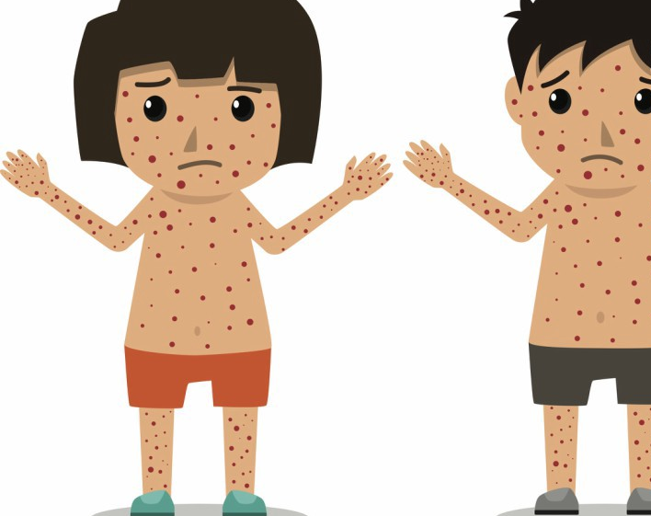
What are Measles
Measles is a very infectious viral disease that is often caught by young children.
It is transmitted through the air in tiny droplets after an infected person sneezes.
It causes a fever and skin rash.
Many children in developed countries are given vaccines against measles, but sadly this is not the case throughout the world.

Slide 6
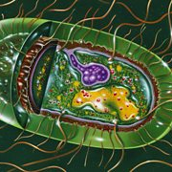
Salmonella
Salmonella is a genus of bacteria that causes food poisoning.
This often means abdominal cramps, vomiting and diarrhoea.
It is often found in unhygienic kitchens, undercooked foods such as meat, eggs and poultry, or the same foods that have not been reheated properly.
To prevent the spread of salmonella in the UK, all poultry are vaccinated against it.

Slide 7

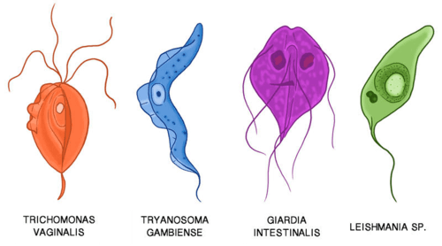
What are Protist Disease
Protists are a group of microorganisms that have features that belong to animals, plants and fungi.
Some are like animals, others more like plants and some, called moulds are closest to fungi.
They are all eukaryotic, which means they have a nucleus.

Slide 8
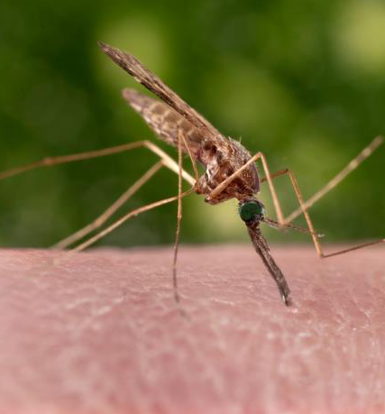
Malaria
Malaria is spread by mosquitos which carry the Plasmodium protist.
Mosquitos suck blood containing the protists from an infected person. They pass the protist, to other people they suck blood from. The mosquitos do not become ill and are called 'vectors' because they transmit the disease.
The symptoms of malaria include a fever, sweats and chills, headaches, vomiting and diarrhoea.

Slide 9
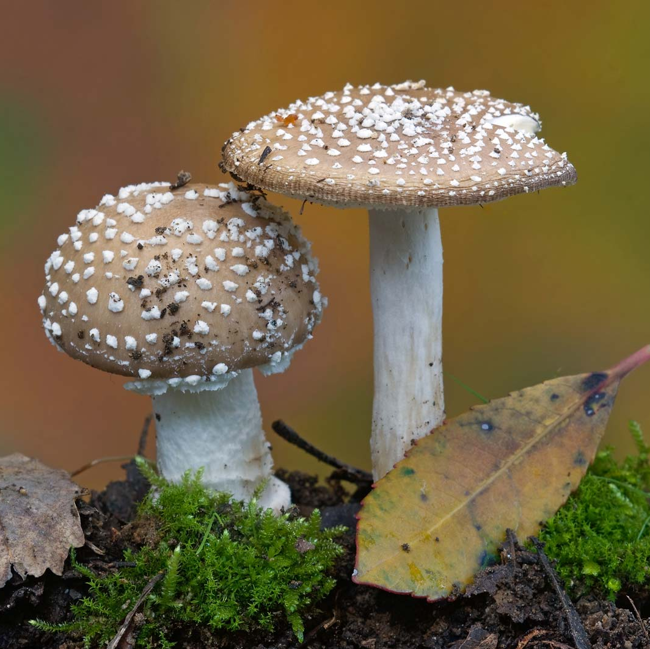
What are fungal diseases?
Not all fungi cause disease. Yeast is a single-celled fungus that is economically important because we use it to make some bread and beer.
Not all fungi are single-celled. Some such as mushrooms are multicellular and so much larger. These are still made of tiny cells like yeast but have many more of them. Fungal cells have a nucleus and so are eukaryotic.

Slide 10

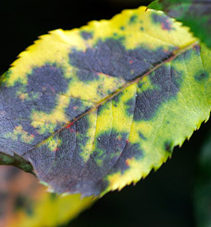
Rose Black Spot
It infects leaves and causes black or purple spots on the leaves. The rest of the leaves often turn yellow and can drop off the plant. This reduces that plant's ability to photosynthesise and reduces growth.
It can be transmitted in air or water, as well as through direct contact by gardeners. It is treatable using fungicides and by removing and destroying infected leaves.

